Slide 1

Whack-A-Mole
Team #16: Elon Mux Final Demo Link: https://youtu.be/pJavIuCu2RQ
Devin Goodwin
Linglong Le
Julian Leguizamon
Chenliang Wang
Notes:
Devin

Slide 2
Goal/Motivation
The goal of this project is to create a fun and interactive Whack-A-Mole game for the FPGA
The Whack-A-Mole works as a stand-alone FPGA board game or with an added peripheral of a VGA
Ideally the game can be played in leisure or friendly competition between friends
Notes:
Devin

Slide 3
Functionality
User can increment the time of the game by 5 seconds by pressing the button.
Can be 0-60 seconds long.
Difficulty can be set from 0 - 2, corresponds to the time user has to hit the mole
Difficulty and Time
Once they press the button to start, the Moles will start popping up. If there’s a VGA connected then they will appear as squares, and regardless leds will light up corresponding to which switch needs to be hit.
VGA
The switch doesn’t have to be in the down position, its position just has to change to count as a hit.
Switches
When a mole is hit, the score increments by 1 until the timer runs out. At which point the game ends
Score incrementation
Notes:
Julian

Slide 4
Specifications
For this design, the requirement was that there would be a component that would interact with the VGA to display the moles.
The moles need to come out at random positions, and need to register that they have been hit when the correct switch is changed.
The VGA, if connected, needs to properly track which moles are currently up, as well as the moment they are hit.
One major requirement for this project was that no peripherals would be needed to play the game. Ideally with just the FPGA alone the game would be able to run.
It was decided that the game would run with a maximum of 8 moles.
The system should record the current score and game time.
Notes:
Chenliang

Slide 5
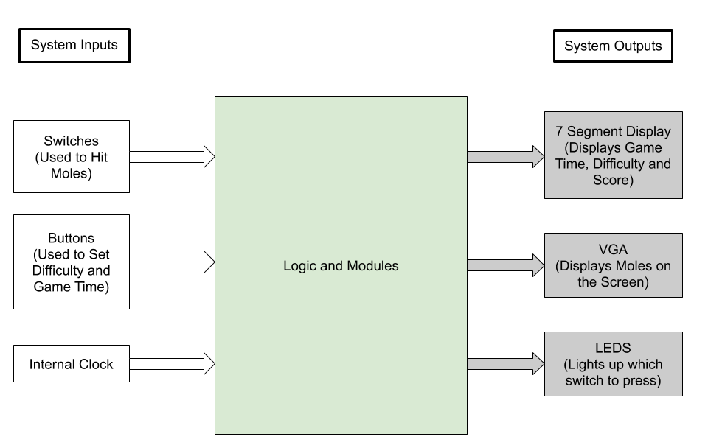
Overall Block Diagram
Notes:
Chenliang

Slide 6
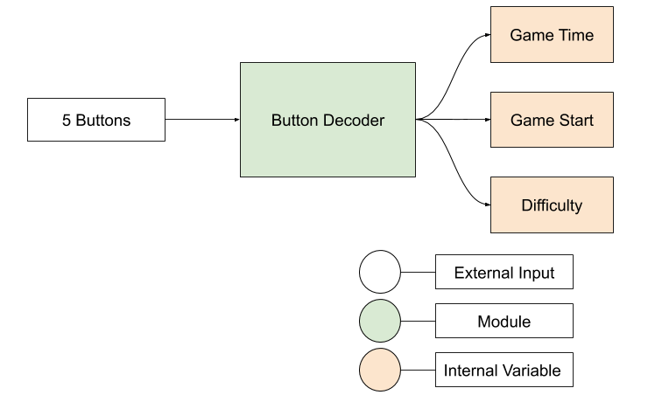
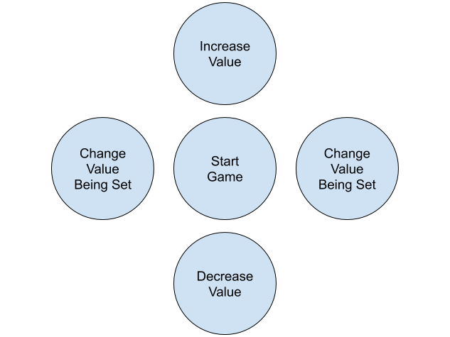
Input Diagram - Buttons
Notes:
Linglong

Slide 7
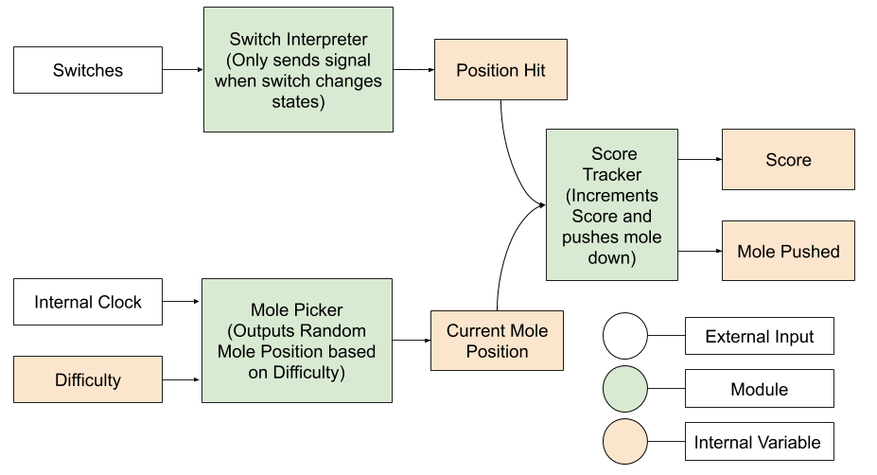
Block Diagram - Mole Gameplay
Notes:
Linglong - Internal Clock that is used with the input difficulty, to determine how much time should be spent between new mole activation
Switch interpreter can detect when a signal goes from high/low i.e changes state, and can use that to determine mole hit.
Mole Picker- Uses the difficulty to determine how many clock cycles should go by before a new mole is sent out.
Score Tracker - Compares position hit & current mole position, to see if score should be incremented

Slide 8
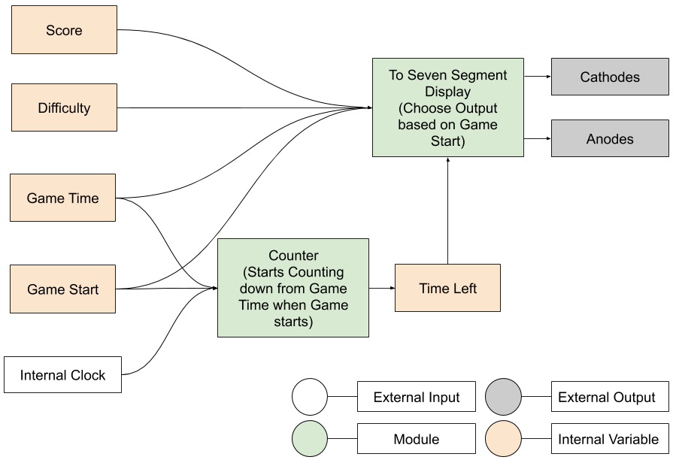
Block Diagram - To Seven Segment Display
Notes:
Chenliang

Slide 9
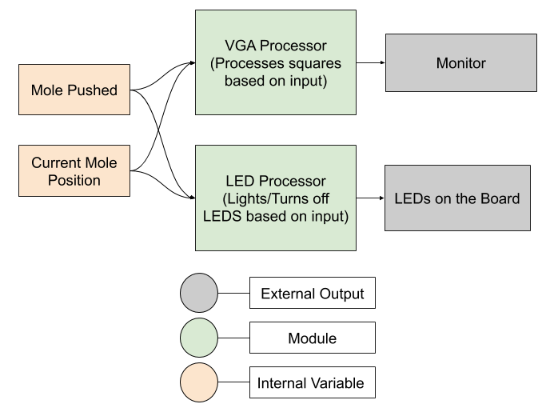
Block Diagram - Outputs to LED / VGA
Notes:
Devin

Slide 10




VGA Display
Empty Grid
Mole in SQ1
Mole Hit

Slide 11
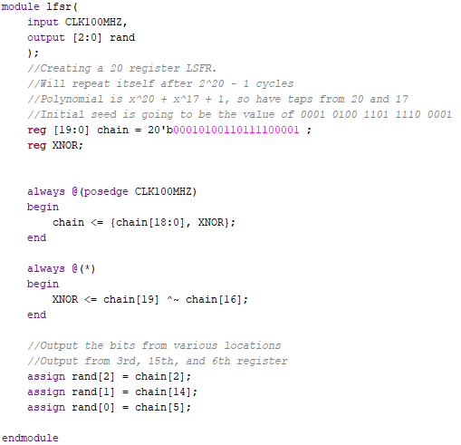
Code Snippet #1 - Linear Feedback Shift Register
Linear Feedback Shift Registers are one of the main ways to generate pseudo-randomized numbers on hardware
The value of the bit being added in to the end is determined by the 20th and the 17th register.
The overall sequence repeats itself after 2^20 - 1 cycles, which is 1,048,575 cycles.
Which values determine the next input are specially configured for each length to ensure that the time it takes for the sequence to repeat is maximized.
Notes:
Linglong

Slide 12
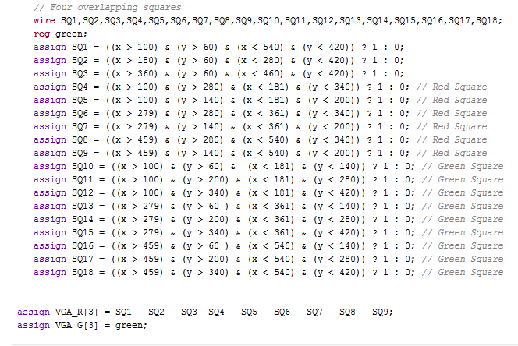

Code Snippet #2 - VGA Mole Representation
Notes:
Julian

Slide 13
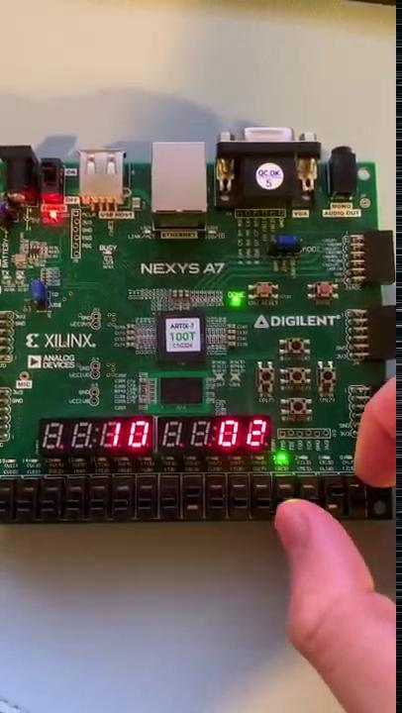
Short Demo of Current Gameplay:
Demo Link: https://drive.google.com/file/d/1RuJjXd6h7__xYRaBvPnvrmDPOBr2uoos/view?usp=sharing
Notes:
Show the Video

Slide 14
Successes - 12/02/2020
As of 12/02/2020:
The FPGA can currently take in the button inputs to set the difficulty of the game, and how long the game can run.
The Mole is randomly generated, and successfully lights up the LED on the FPGA board.
The Mole is pushed down when its corresponding switch is hit.
The Seven Segment Display is able to display the time, difficulty, and keep track of the score as it updates.
The FPGA was able to interface with the VGA to display distinct squares on the monitor.
Notes:
Chenliang

Slide 15
Failures as of 12/02/2020
VGA Display
Multiple Moles
Time Interval
Switch Fail
Still have to merge the VGA displaying capabilities with the current Mole Generation.
We wanted to have multiple moles pop up at random intervals. While we were able to achieve random intervals, we are still working on having multiple moles on the VGA
Currently we have hard set times between mole. We still need to add in code that actually randomizes how long the mole is up for.
Occasionally, hitting a switch will fail to register the mole being hit down. One way to fix this issue would be to increase the length of the switch hit signal being high.
Notes:
Julian

Slide 16
Project Wrap Up 12/7/2020
We were able to resolve or improve on of the failures from the 2nd. The VGA’s ability to interface with the FPGA to display the squares was verified
Code was included that makes it so that the moles themselves pop down after a random amount of time, as well as allowing for the handling of more than one mole being up at the same time
The issue with switch inputs not catching the mole has been improved. While the switch will still occasionally to catch the mole, it occurs much less frequently now.
Final Demo Link: https://youtu.be/pJavIuCu2RQ

